Slide 1

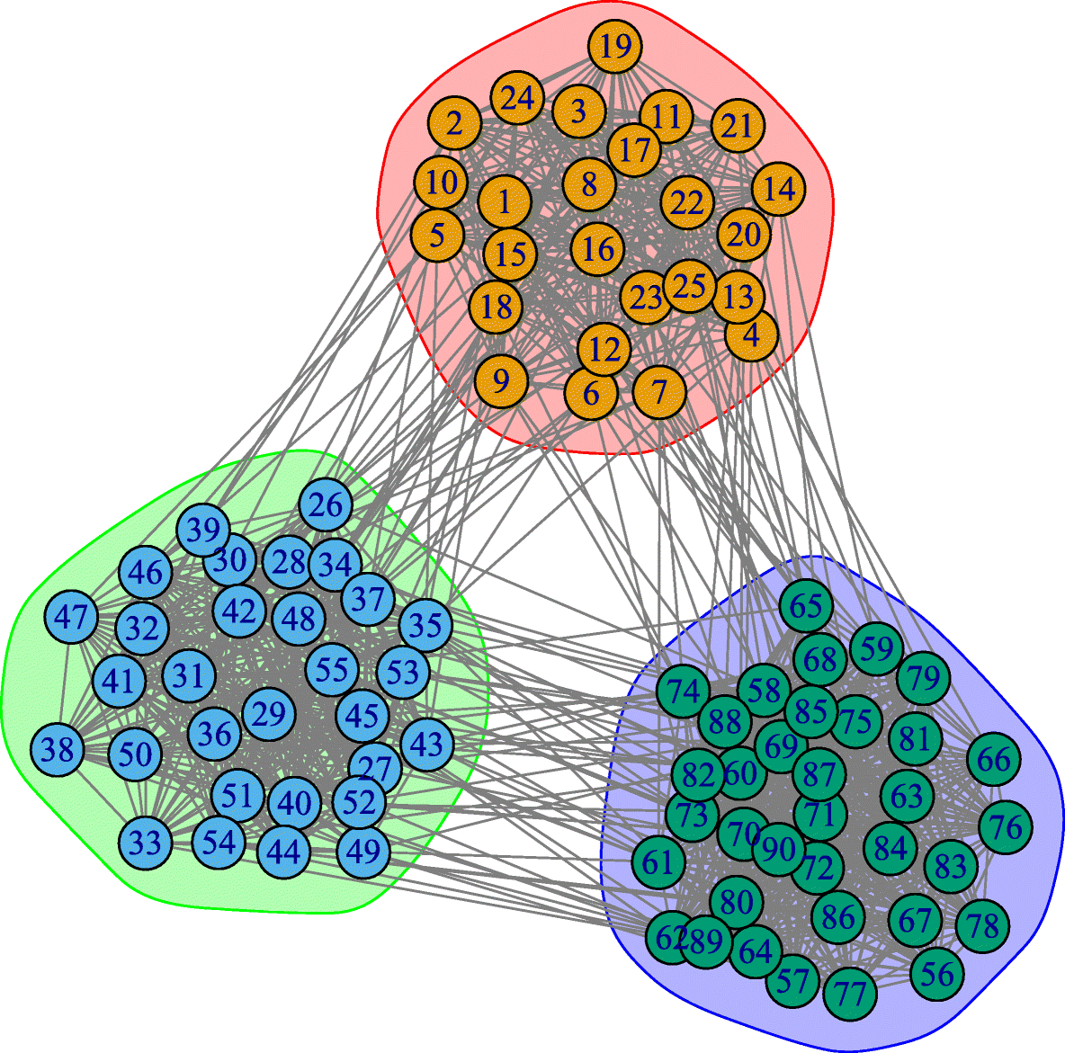

Stochastic Block Models for Directed Graphs
Mrinmoy Banik
BS2012

Slide 2
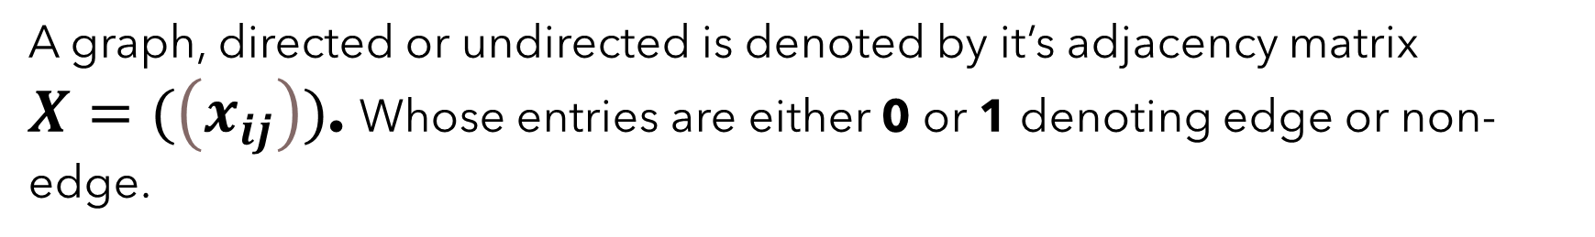

Basic Notation And Terminology :-
A graph, directed or undirected is denoted by it’s adjacency matrix
$X=(\left(x_{ij}\right))$. Whose entries are either 0 or 1 denoting edge or non-edge.
$G_{n}$ is the sample space of all possible graphs with n nodes.
$p_{ij}$ denotes the probability of the directed edge $ⅈ→j$ appearing in
a random sample graph $G∈G_{n}$and $ⅆ_{i}$ is the out-degree of
the ith node.

Slide 3
A Brief History of Static Network Models
1959-1960
1981
2006-2011
The Sparse Beta-Model by Britton et al.
Erdos-Renyi-Gilbert Random Graph Model
P1 Stochastic Block Model by Holland & Leinhardt
2004
P2 Model by M.A.J van Duijn et. al.
Outside the Scope of this presentation!

Slide 4
Erdos-Renyi-Gilbert Random Graph Model

Slide 5
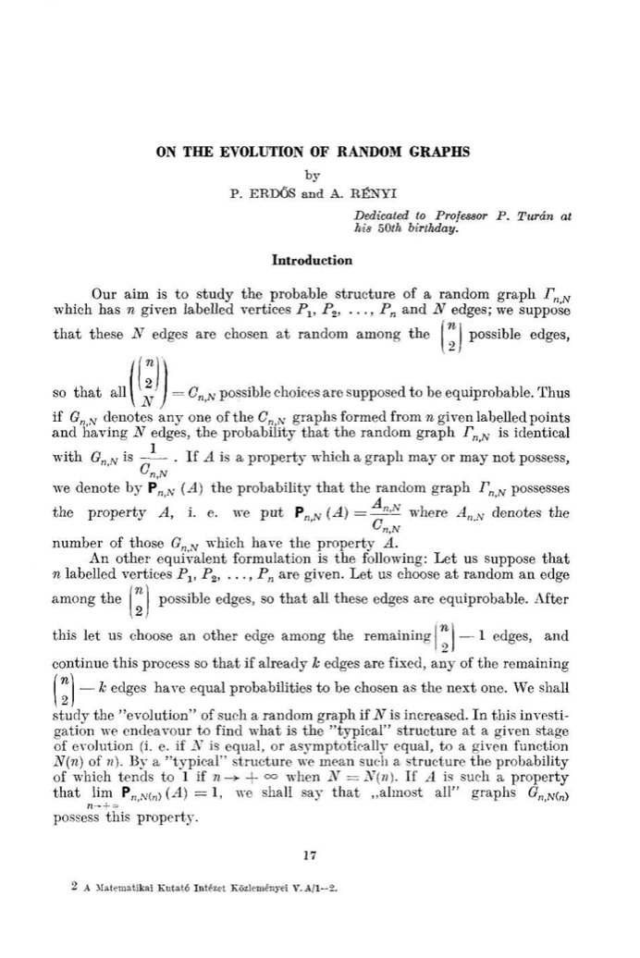


Some Backround
Paul Erdős (Hungarian: Erdős Pál [ˈɛrdøːʃ ˈpaːl]; 26 March 1913 – 20 September 1996) was a Hungarian mathematician. He was one of the most prolific mathematicians and producers of mathematical conjectures^{[2]} of the 20th century.^{[3]} Erdős pursued and proposed problems in discrete mathematics, graph theory, number theory, mathematical analysis, approximation theory, set theory, and probability theory.
Alfréd Rényi (20 March 1921 – 1 February 1970) was a Hungarian mathematician known for his work in probability theory, though he also made contributions in combinatorics, graph theory, and number theory.

Slide 6
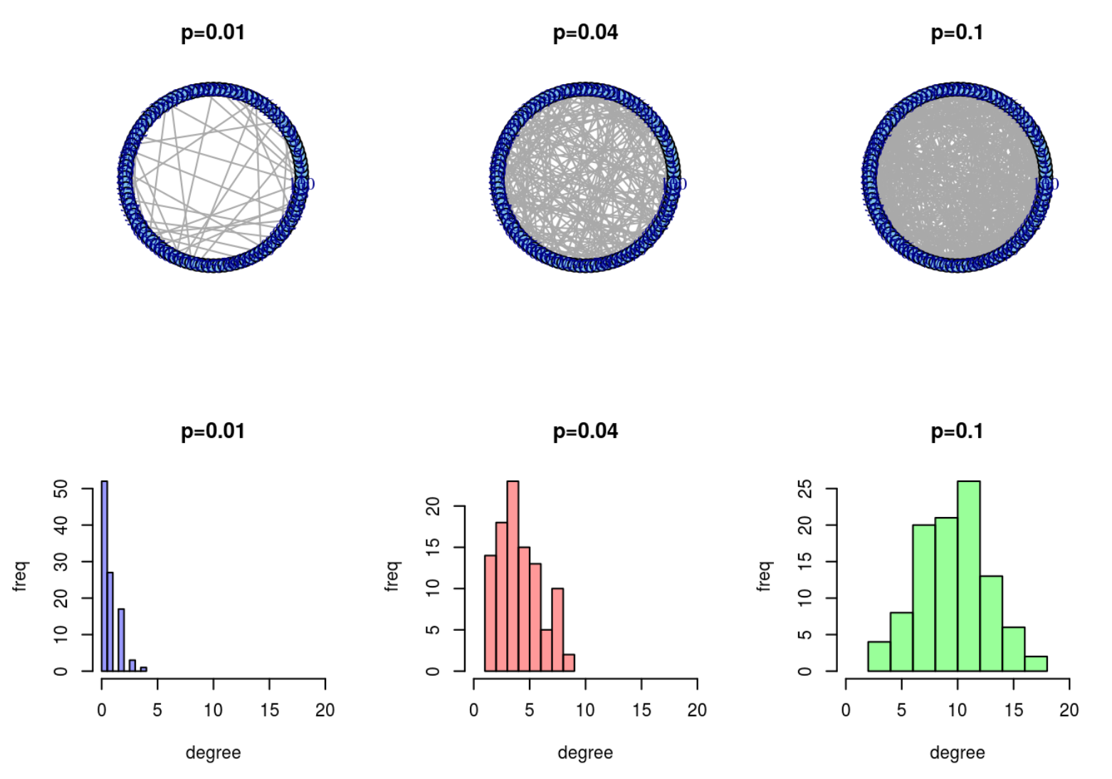
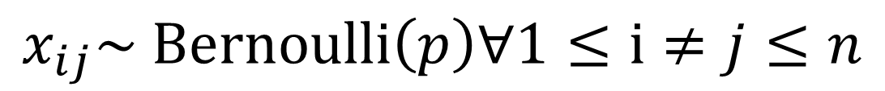

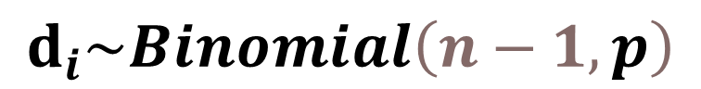
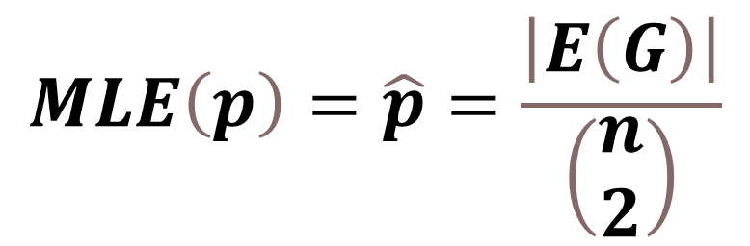
Erdos-Renyi-Gilbert Random Graph Model:-
$p_{ij}=p=const$
$$x_{ij}\sim Bernoulli\left(p\right)∀1≤ⅈ≠j≤n$$
iid
$$ⅆ_{i}\sim Binomial\left(n−1,p\right)$$
$$MLE\left(p\right)=\hat{p}=\frac{\left|E\left(G\right)\right|}{\left(\begin{matrix}n \\ 2\end{matrix}\right)}$$

Slide 7
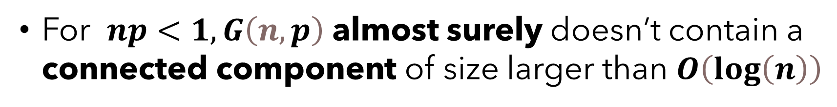

Properties of Erdos-Renyi-Gilbert Model:-
If np is held constant and $n→∞$ then $ⅆ_{i}\underset{→}{D}Poisson(np)$
For $np<1,G\left(n,p\right)$ almost surely doesn’t contain a connected component of size larger than $O\left(\log\left(n\right)\right)$
For $np=1,G\left(n,p\right)$ almost surely has a connected component of size $O\left(n^{2/3}\right)$

Slide 8
Some Simulations of Erdos-Renyi-Gilbert Model

Slide 9
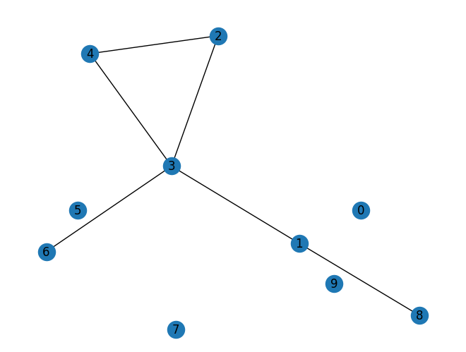
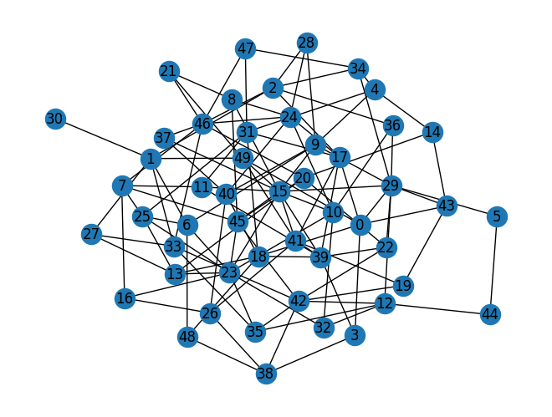
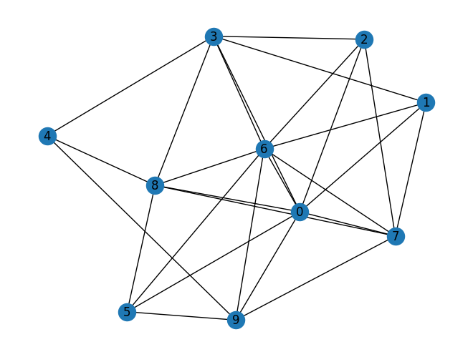
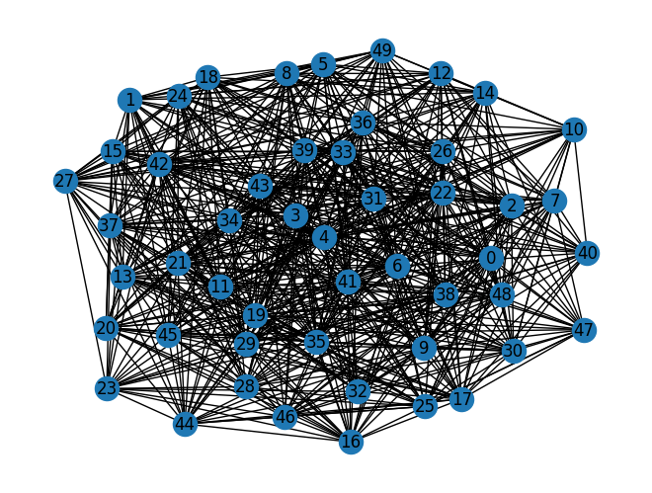
Erdos-Renyi -Gilbert Model | N=10 | N=50
P=0.1
P=0.5

Slide 10
Advantages :-
Simple mathematical construction with only 1 parameter which is easily estimable using standard techniques like MLE and has nice properties including asymptotic poisson degree distribution.
Disadvantages :-
It can only be used to model graphs where the edges are independent and equally likely which are extremely unrealistic for most practical assumptions like social networks.

Slide 11
p1-Model proposed by Holland and Leinhardt

Slide 12
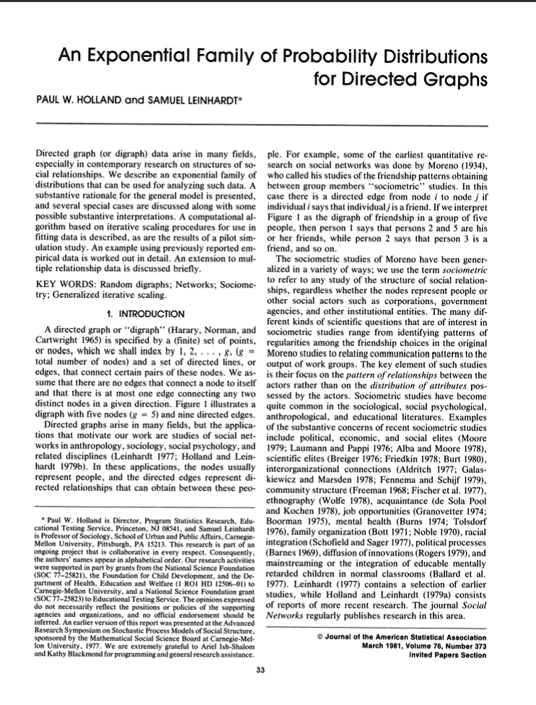


Some Backround
Paul W. Holland is an American statistician. He has worked on a wide range of fields including: categorical data analysis, social network analysis and causal inference in program evaluation.Paul Holland was born 25 April 1940 in Tulsa, Oklahoma. He went to the University of Michigan as an undergraduate, and Stanford University for the master's and doctorate in statistics. Michigan State University and Harvard University were his first teaching posts.
Samuel Leinhardt is an American mathematician and professor of Sociology, School of Urban and Public Affairs in Carnegie-Mellon University, Pittsburgh, Pennsylvania

Slide 13
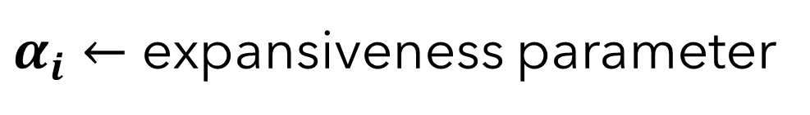
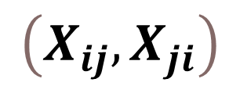
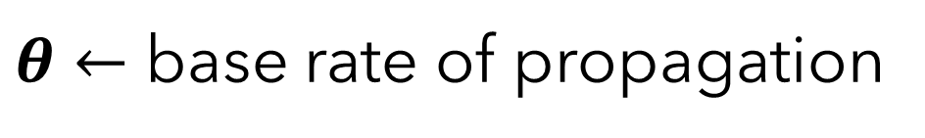
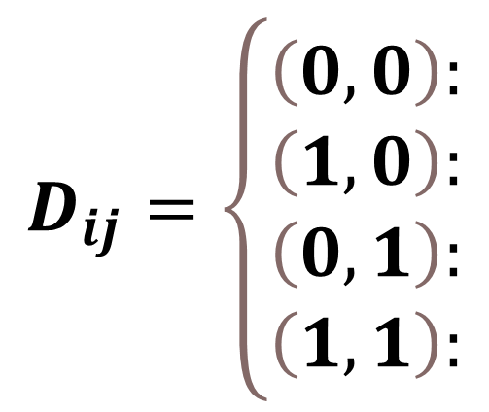
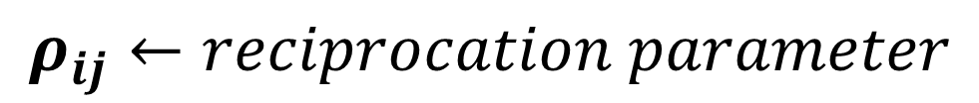
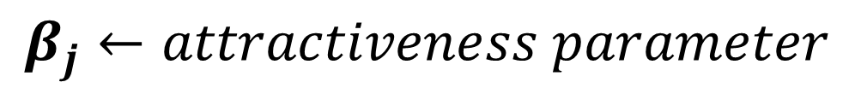
Social Network Modelling using p1 model:-
A conceptually separate thread of research developed in parallel in the statistics and social sciences literature, starting with the introduction of the p1 model. Holland and Leinhardt’s p1 model focuses on dyadic pairings and keeps track of whether node i links to j, j to i, neither, or both. It contains the following parameters:
$$\left(X_{ij},X_{ji}\right)$$
$θ←$ base rate of propagation
$$D_{ij}=\left\{\begin{matrix}\left(0,0\right): \\ \left(1,0\right): \\ \left(0,1\right): \\ \left(1,1\right):\end{matrix}\right.$$
No edge between i & j
$α_{i}←$ expansiveness parameter
Only i→j edge is present
$$β_{j}←attractiveness parameter$$
Only i←j edge is present
Both i→j & i←j edges are present
$$ρ_{ij}←reciprocation parameter$$
Pairs/
Dyads

Slide 14
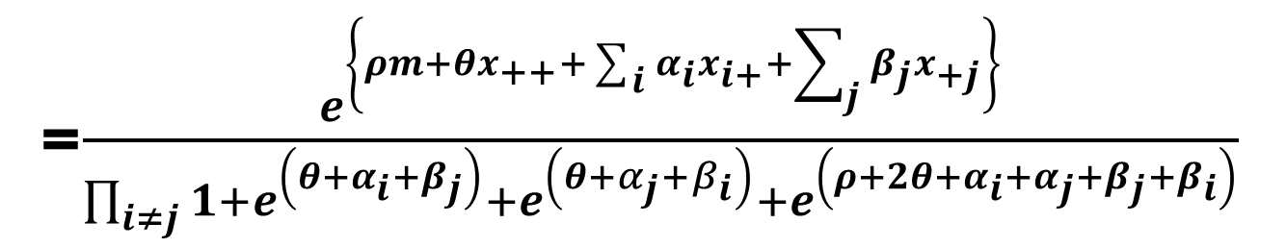
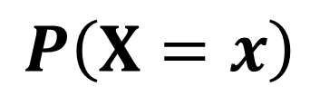
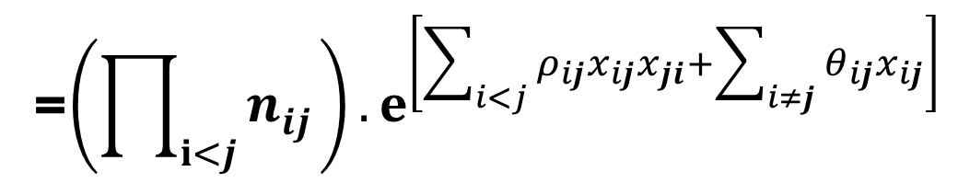
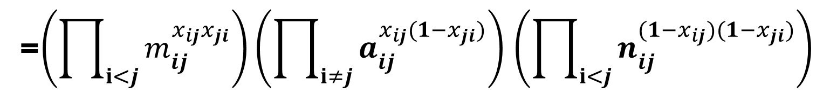
Distribution and likelihood of p1 model:-
Adjacency
random matrix
‘m’ is the sum of node pairs with both way edges
=$\frac{ⅇ^{\left\{ρm+θx_{++}+\sum_{i}{α_{i}}x_{i+}+\sum_{j}{β_{j}x_{+j}}\right\}}}{\prod_{i≠j}{1}+ⅇ^{\left(θ+α_{i}+β_{j}\right)}+ⅇ^{\left(θ+α_{j}+β_{i}\right)}{+ⅇ}^{\left(ρ+2θ+α_{i}+α_{j}+β_{j}+β_{i}\right)}}$
$$P\left(X=x\right)$$
=$\left(\prod_{ⅈ<j}{m_{ij}^{x_{ij}x_{ji}}}\right)\left(\prod_{ⅈ≠j}{a_{ij}^{x_{ij}({1−x}_{ji})}}\right)$ $\left(\prod_{ⅈ<j}{n_{ij}^{{(1−x}_{ij})(1−x_{ji})}}\right)$
=${\left(\prod_{ⅈ<j}{n_{ij}^{}}\right).ⅇ}^{\left[\sum_{i<j}{ρ_{ij}x_{ij}x_{ji}}+\sum_{i≠j}{θ_{ij}x_{ij}}\right]}$

Slide 15
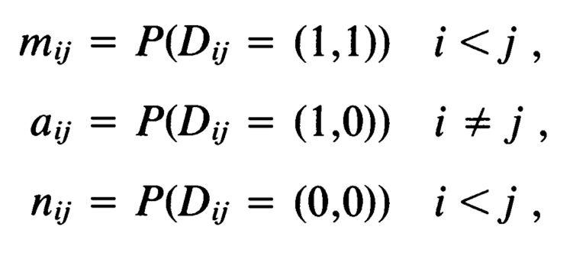
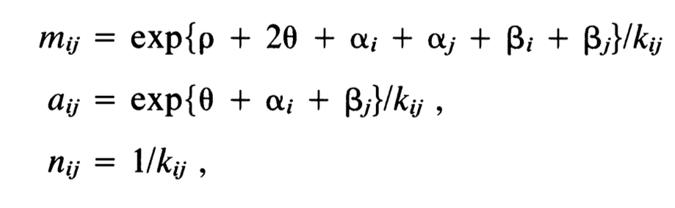
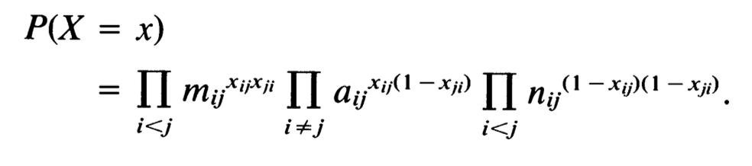
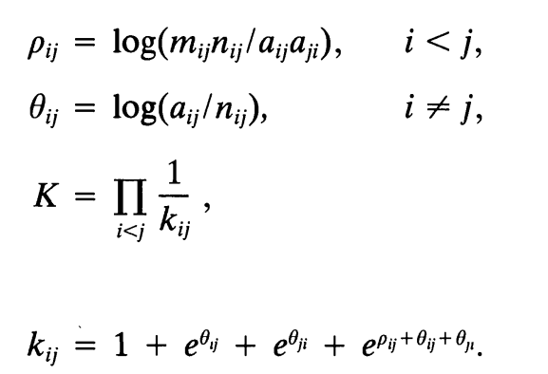
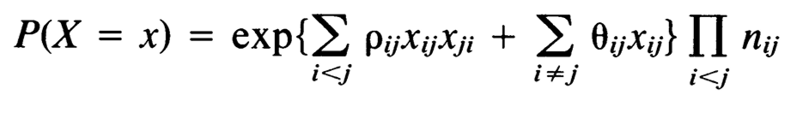
Derrivation and Generalization:-

Slide 16
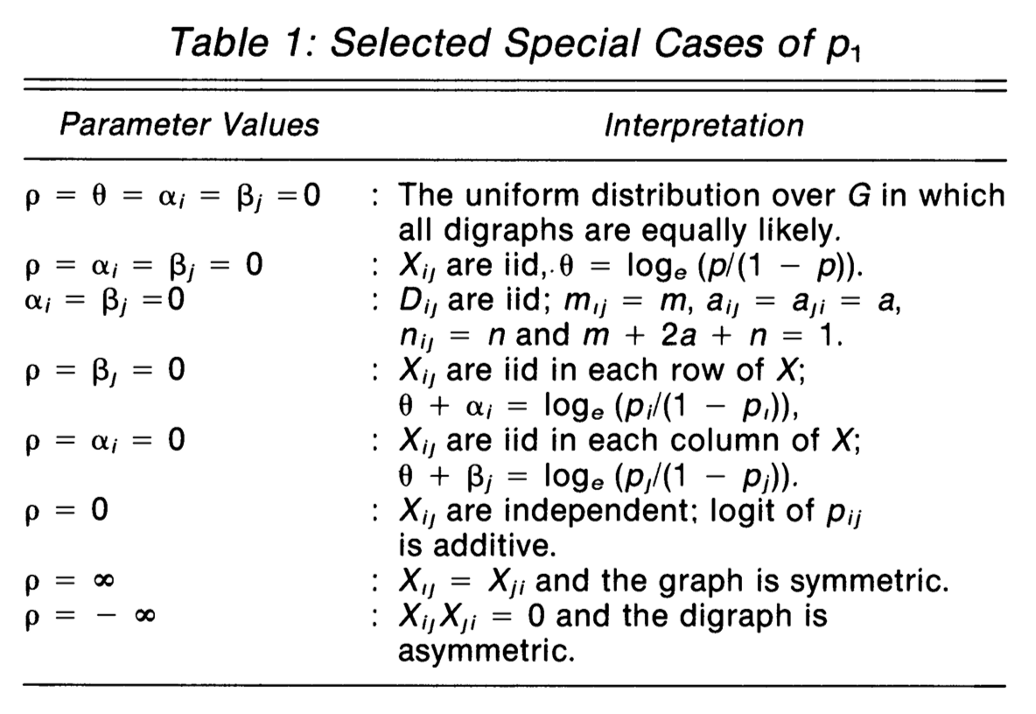
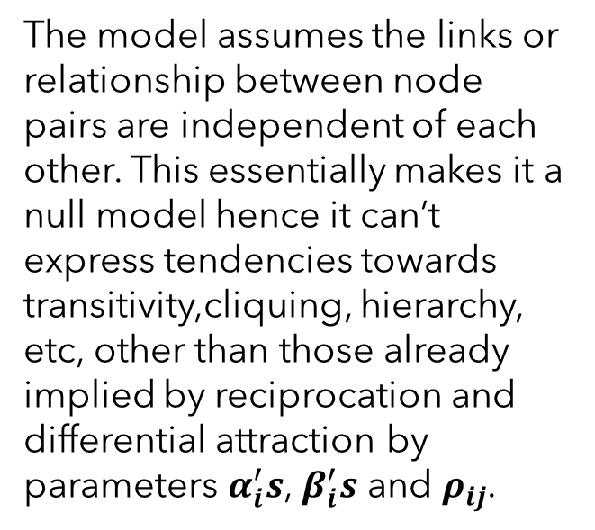
Restrictions and assumptions of p1 model:-
The model assumes the links or relationship between node pairs are independent of each other. This essentially makes it a null model hence it can’t express tendencies towards transitivity,cliquing, hierarchy, etc, other than those already implied by reciprocation and differential attraction by parameters $α_{i}^{′}s$, $β_{i}^{′}s$ and $ρ_{ij}$.

Slide 17
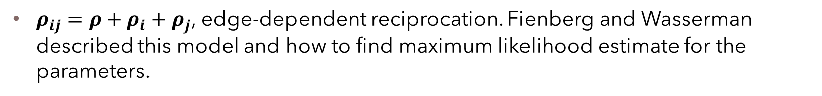
Special Cases:-
$α_{i}$ = 0, $β_{j}$ = 0, and $ρ_{ij}$ = 0. This is basically an Erdos-Renyi-Gilbert model for directed graphs: each directed edge has the same probability of appearance.
$ρ_{ij}$ = 0, no reciprocal effect. This model effectively focuses solely on the degree distributions into and out of nodes.
$ρ_{ij}$ = ρ, constant reciprocation. This was the version of the p1 model studied in depth by Holland and Leinhardt using maximum likelihood estimation.
$ρ_{ij}=ρ+ρ_{i}+ρ_{j}$, edge-dependent reciprocation. Fienberg and Wasserman described this model and how to find maximum likelihood estimate for the parameters.

Slide 18
Some Simulations of p1 Block Model

Slide 19
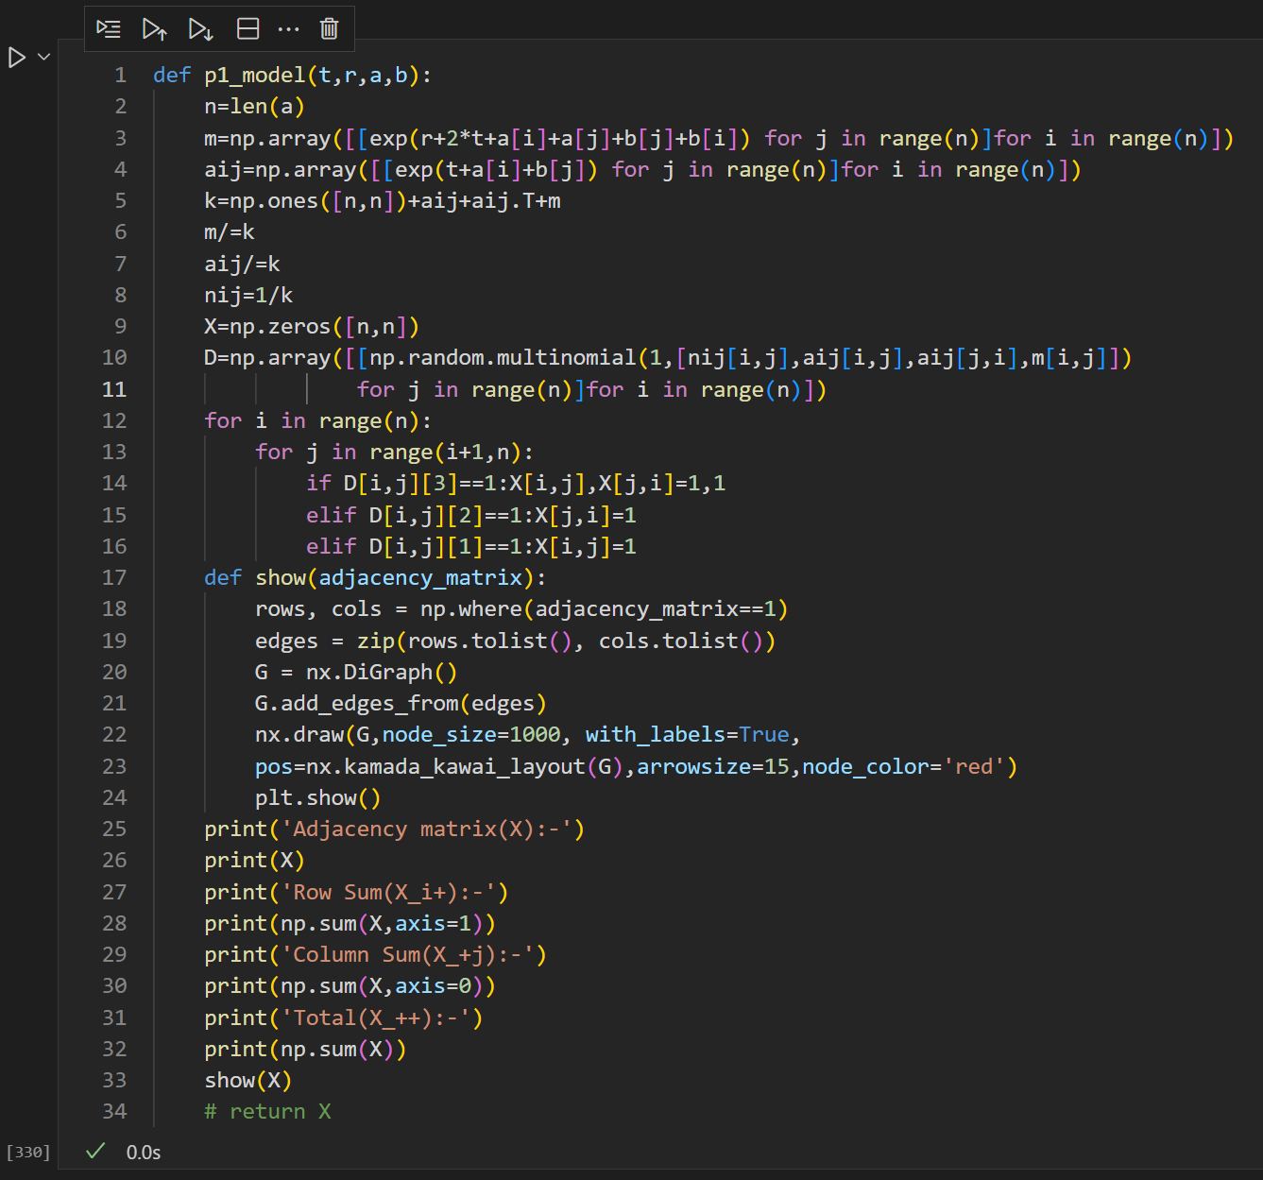
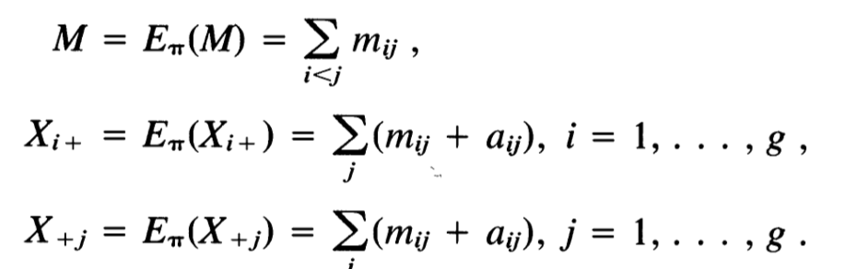
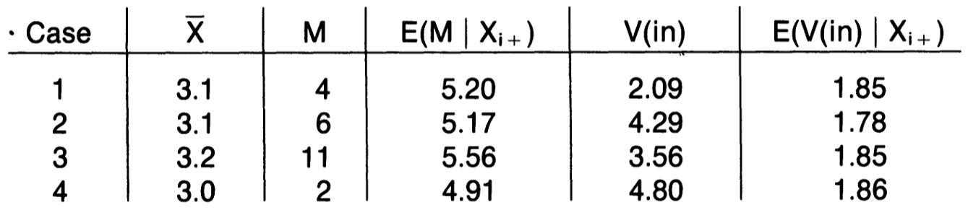
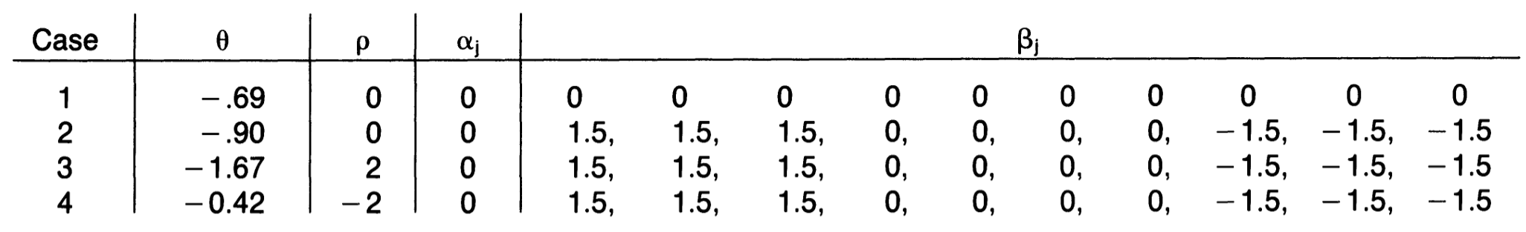
Pseudo-Code and Test Cases:-

Slide 20
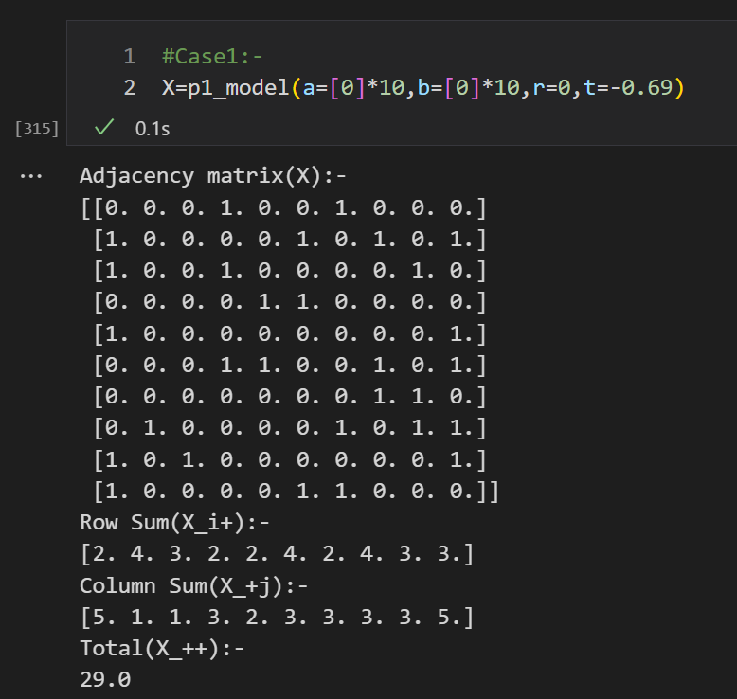
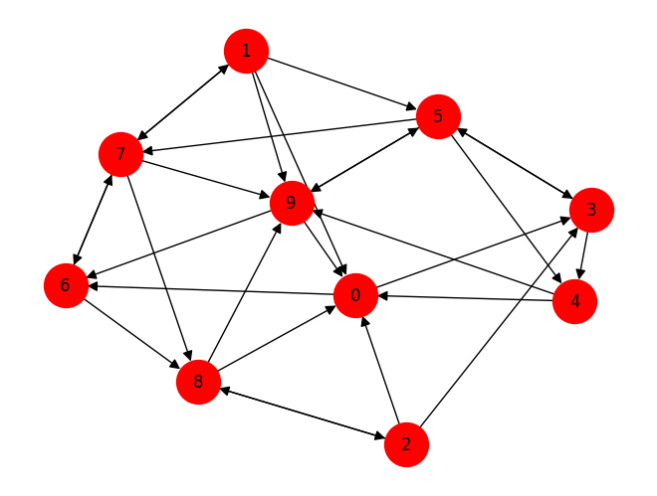
Case1:-

Slide 21
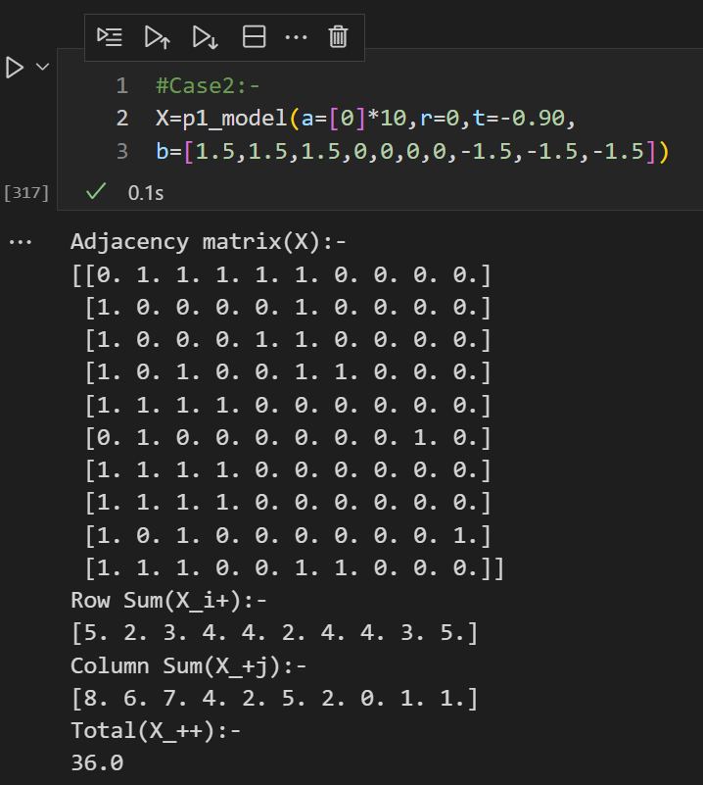
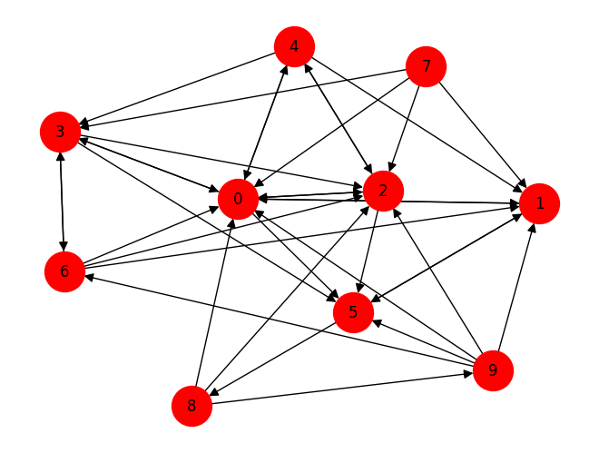
Case2:-

Slide 22
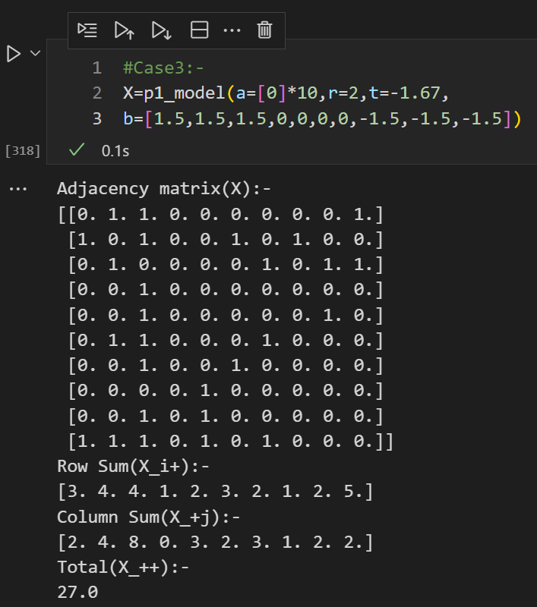
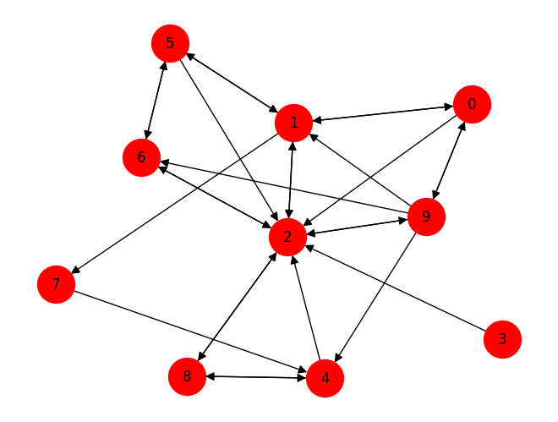
Case3:-

Slide 23

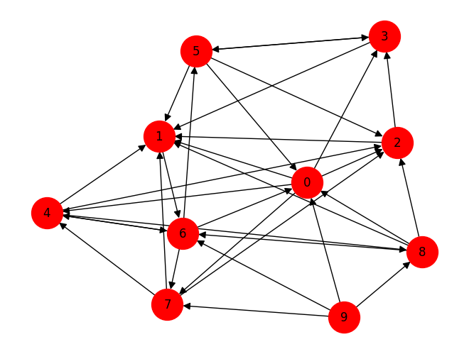
Case4:-

Slide 24
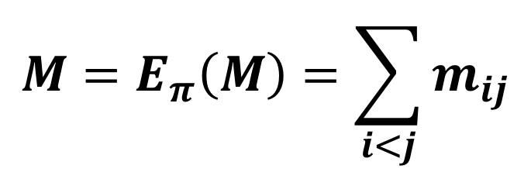
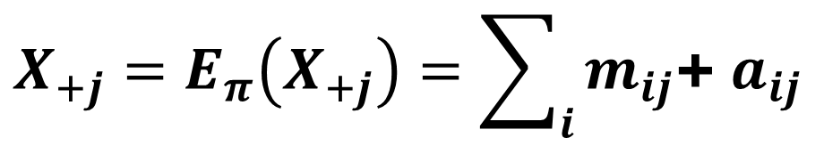
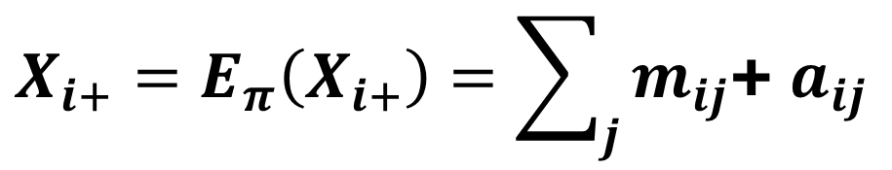
Estimation of Parameters:-
$$π=\left(ρ,θ,α_{1},α_{2},…,α_{n},β_{1},β_{2},…β_{n}\right)$$
Estimable
parameters
∵ p1 is an exponential family model, MLE is obtained by setting it’s sufficient statistics to it’s expectation, so we get the following system of eq:-
Row totals
$X_{i+}=E_{π}\left(X_{i+}\right)=\sum_{j}{m_{ij}}$+ $a_{ij}$
$$M=E_{π}\left(M\right)=\sum_{i<j}{m_{ij}}$$
$X_{+j}=E_{π}\left(X_{+j}\right)=\sum_{i}{m_{ij}}$+ $a_{ij}$
Mutual co-occurrences
Column totals

Slide 25
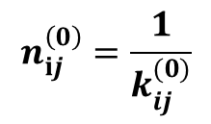
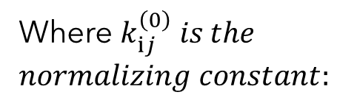
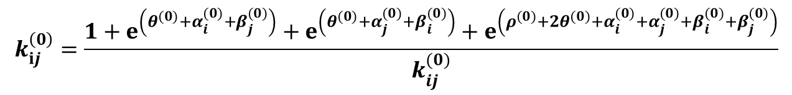
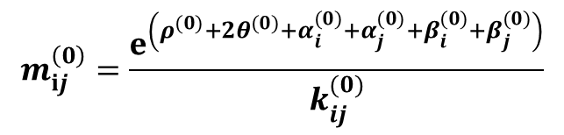
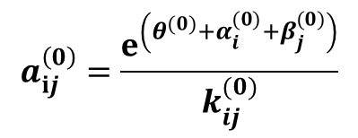
Iterative Scaling Algorithm by Darroch and Ratcliff:-
Start with an initial guess:
$$π^{(0)}=\left(ρ^{(0)}, θ^{(0)},{α_{1}}^{(0)},{α_{2}}^{(0)},…,{α_{n}}^{(0)},{β_{1}}^{(0)},{β_{2}}^{(0)},…{β_{n}}^{(0)}\right)$$
$$m_{ⅈj}^{\left(0\right)}=\frac{ⅇ^{\left(ρ^{(0)}+2θ^{(0)}+α_{i}^{(0)}+α_{j}^{(0)}+β_{i}^{(0)}+β_{j}^{(0)}\right)}}{k_{ij}^{(0)}}$$
$$a_{ⅈj}^{\left(0\right)}=\frac{ⅇ^{\left(θ^{(0)}+α_{i}^{(0)}+β_{j}^{(0)}\right)}}{k_{ij}^{(0)}}$$
$$n_{ⅈj}^{\left(0\right)}=\frac{1}{k_{ij}^{(0)}}$$
Obtain dyad probabilities:
Where $k_{ⅈj}^{\left(0\right)} is the$
$normalizing constant:$
$$k_{ⅈj}^{\left(0\right)}=\frac{1+ⅇ^{\left(θ^{(0)}+α_{i}^{(0)}+β_{j}^{(0)}\right)}+ⅇ^{\left(θ^{(0)}+α_{j}^{(0)}+β_{i}^{(0)}\right)}+ⅇ^{\left(ρ^{(0)}+2θ^{(0)}+α_{i}^{(0)}+α_{j}^{(0)}+β_{i}^{(0)}+β_{j}^{(0)}\right)}}{k_{ij}^{(0)}}$$

Slide 26







Iterative Scaling Algorithm Continued (Row Step):-
Now we will iteratively compute the ${(r+1)}^{th}$ step using the values at $r^{th}$ step. For all $ⅈ≠j$ perform the $r^{th}$ row step as follows:-
$$m_{ⅈj}^{\left(r+1\right)}=m_{ⅈj}^{\left(r\right)}{\left(F_{i}^{\left(r\right)}F_{j}^{\left(r\right)}\right)}^{\frac{1}{2}}$$
$$a_{ⅈj}^{\left(r+1\right)}=a_{ⅈj}^{\left(r\right)}{\left(F_{i}^{\left(r\right)}K^{(r)}\right)}^{\frac{1}{2}}$$
$$n_{ⅈj}^{\left(r+1\right)}=n_{ⅈj}^{\left(r\right)}K^{(n)}$$
Where $F_{ⅈ}^{\left(r\right)}$ and $K^{(r)}$ are computed from the graph’s adjacency matrix and previous step’s dyad probabilities as follows
$$:$$
$$F_{ⅈ}^{\left(r\right)}=\frac{X_{i+}}{m_{ⅈ+}^{\left(r\right)}+a_{ⅈ+}^{\left(r\right)}}$$
$$K^{(r)}=\frac{{n\left(n−1\right)−X}_{++}}{a_{++}^{\left(r\right)}+n_{++}^{\left(r\right)}}$$

Slide 27







Iterative Scaling Algorithm Continued (Column Step):-
Similarly for all $ⅈ≠j$ perform the ${(r+2)}^{th}$ column step on the ${(r+1)}^{th}$ row step computed previously as follows:-
$$m_{ⅈj}^{\left(r+2\right)}=m_{ⅈj}^{\left(r+1\right)}{\left(G_{i}^{\left(r+1\right)}G_{j}^{\left(r+1\right)}\right)}^{\frac{1}{2}}$$
$$a_{ⅈj}^{\left(r+2\right)}=a_{ⅈj}^{\left(r+1\right)}{\left(G_{j}^{\left(r+1\right)}K^{(r+1)}\right)}^{\frac{1}{2}}$$
$$n_{ⅈj}^{\left(r+2\right)}=n_{ⅈj}^{\left(r+1\right)}K^{(n+1)}$$
Where $G_{ⅈ}^{\left(r+1\right)}$ and $K^{(r+1)}$ are computed from the graph’s adjacency matrix and previous dyad probabilities as follows
$$:$$
$$G_{ⅈ}^{\left(r+1\right)}=\frac{X_{+j}}{m_{+j}^{\left(r+1\right)}+a_{+j}^{\left(r+1\right)}}$$
$$K^{(r+1)}=\frac{{n\left(n−1\right)−X}_{++}}{a_{++}^{\left(r+1\right)}+n_{++}^{\left(r+1\right)}}$$

Slide 28






Iterative Scaling Algorithm Continued (Mutual Step):-
Similarly for all $ⅈ≠j$ perform the ${(r+3)}^{th}$ mutual step on the ${(r+2)}^{th}$ column step computed previously as follows:-
$$m_{ⅈj}^{\left(r+3\right)}=m_{ⅈj}^{\left(r+2\right)}H^{(r+2)}$$
$$a_{ⅈj}^{\left(r+3\right)}=a_{ⅈj}^{\left(r+2\right)}L^{(r+2)}$$
$$n_{ⅈj}^{\left(r+3\right)}=n_{ⅈj}^{\left(r+2\right)}L^{(r+2)}$$
Where${ H}^{(r+2)}$and $L^{(r+2)}$ are computed from the graph’s adjacency matrix and previous dyad probabilities as follows
$$:$$
$$L^{(r+2)}=\frac{\left(\begin{matrix}n \\ 2\end{matrix}\right)−M}{\left(\begin{matrix}n \\ 2\end{matrix}\right)−{\frac{1}{2}m}_{++}^{\left(r+2\right)}}$$
$$H^{(r+2)}=\frac{M}{{\frac{1}{2}m}_{++}^{\left(r+2\right)}}$$

Slide 29





Iterative Scaling Algorithm Continued (Normalizing Step):-
Lastly for all $ⅈ≠j$ perform the ${(r+4)}^{th}$ normalizing step on the ${(r+3)}^{th}$ mutual step computed previously as follows:-
$$m_{ⅈj}^{\left(r+4\right)}=\frac{m_{ⅈj}^{\left(r+3\right)}}{R_{ⅈj}^{\left(r+3\right)}}$$
$$a_{ⅈj}^{\left(r+4\right)}=\frac{a_{ⅈj}^{\left(r+3\right)}}{R_{ⅈj}^{\left(r+3\right)}}$$
$$n_{ⅈj}^{\left(r+4\right)}=\frac{n_{ⅈj}^{\left(r+3\right)}}{R_{ⅈj}^{\left(r+3\right)}}$$
Where $R_{ⅈj}^{\left(r+3\right)} is$ a normalizing constant obtained from previous step’s dyad probabilities as follows
$$:$$
$R_{ⅈj}^{\left(r+3\right)}=m_{ⅈj}^{\left(r+4\right)}$+ $a_{ⅈj}^{\left(r+4\right)}$ $+a_{ji}^{\left(r+4\right)}$+ $n_{ⅈj}^{\left(r+4\right)}$

Slide 30





Hypothesis Testing:-
Consider the following set of Hypothesis:-
$H_{0}: ρ=0,\left\{β_{j}=0\right\}; θ,\{α_{i}\}$ unconstrained
$H_{1}: ρ=0,; θ,\left\{β_{j}\right\},\{α_{i}\}$ unconstrained
$H_{2}:\left\{β_{j}=0\right\}; ρ,θ,\{α_{i}\}$ unconstrained
$H_{3}: ρ,\left\{β_{j}\right\},θ,\left\{α_{i}\right\}$ unconstrained
If $\left\{β_{j}=0\right\},$ $to test for$reciprocation can be performed as $H_{0}$ vs $H_{2}$ using the conditional distribution of M given {$X_{i+}$} under $H_{0}$. Assuming normal approximation it’s same as 1 sample t-test on M with mean $E_{H_{0}}\left(\left.M\right|\left\{X_{i+}\right\}\right)$ and standard deviation $\sqrt{V_{H_{0}}\left(\left.M\right|\left\{X_{i+}\right\}\right)}$

Slide 31




Likelihood Ratio Testing:-
Let$(m_{ⅈj}^{∗}$, $a_{ⅈj}^{∗}$, $n_{ⅈj}^{∗})$ be the MLE’s under $H_{1}$ and $({\hat{m}}_{ij},{\hat{a}}_{ij}{\hat{n}}_{ij})$ be the MLE’s under $H_{3}$
If $\left\{β_{j}≠0\right\},$ $then test for$reciprocation can be performed as $H_{1}$ vs $H_{3}$with likelihood ratio defined as follows:-
LLR$=−2\log\left(λ\right)=L_{m}+L_{a}+L_{n}$
$$L_{m}=2\sum_{i<j}{X_{ij}X_{ji}∗ln\left(\frac{{\hat{m}}_{ij}}{m_{ⅈj}^{∗}}\right)}$$
$$L_{a}=2\sum_{i<j}{X_{ij}(1−X_{ji})∗ln\left(\frac{{\hat{a}}_{ij}}{a_{ⅈj}^{∗}}\right)}$$
$$L_{n}=2\sum_{i<j}{{(1−X}_{ij})(1−X_{ji})∗ln\left(\frac{{\hat{n}}_{ij}}{n_{ⅈj}^{∗}}\right)}$$

Slide 32
p1 Block Model Modification by Wang and Wong

Slide 33



Some Backround
Dr. Yuchung J. Wang studied modeling categorical data and social networks under Professor Paul W. Holland. In 1987, he is among the first to use external attributes to understand the internal structure of social networks. Dr. Holland and he invented the local dependence function to study dependence among features, and between parameter and variable. He won a competitive scholarship to visit the Graduate School of Business at University of Chicago in 1993, and Marshal School of Business at University of Southern California in 1998. While he was a research Fellow at Institute of Statistical Science, Academia Sinica in Taipei, Dr. Wang promoted quality engineering (Taguchi Method), and several of his projects won national quality awards of Republic of China.
George Y. Wong is Assistant Member, Division of Biostatistics, Memorial Sloan Kettering Cancer Center, 1275 York Avenue, New York, NY 10021. The research of George Wong was partially supported by National Cancer Institute Grant CA-08748 and Office of Naval Research.

Slide 34







Drawbacks of Holland’s p1 Model:-
The p1 model proposed by holland had the following restrictions on the reciprocation parameter and base density parameter:
$$ρ_{ij}=ρ=const$$
$θ_{ij}=$ ${θ+α}_{i}+β_{j}$
This $2^{nd}$ additivity assumption fails to capture the tendency of people to form local social clusters called blocks. Hence in 1987 Wong and Wang suggested adding an block interaction term $λ_{kl}$ to the expression of $θ_{ij}$. So the nodes are partitioned into b blocks $B_{1},$ $B_{2},$ …, $B_{b}$
$θ_{ij}=$ ${θ+α}_{i}+β_{j}+\sum{{d_{ijkl}λ}_{kl}}$
$$d_{ijkl}=\left\{\begin{matrix}1 :(i,j)∈B_{k}×B_{l} \\ 0 : otherwise \end{matrix}\right.$$
Imposing identifiability constraint, $λ_{k+}=0=λ_{+l}$we get the following modified distribution
$$:$$
$P\left(X=x\right)$=$\frac{ⅇ^{\left\{ρm+θx_{++}+\sum_{i}{α_{i}}x_{i+}+\sum_{j}{β_{j}x_{+j}}+\sum_{k,l}{λ_{kl}x_{++}(B_{k}×B_{l})}\right\}}}{\prod_{i≠j}{1}+ⅇ^{\left(θ+α_{i}+β_{j}\right)}+ⅇ^{\left(θ+α_{j}+β_{i}\right)}{+ⅇ}^{\left(ρ+2θ+α_{i}+α_{j}+β_{j}+β_{i}\right)}}$

Slide 35







Maximum Likelihood Estimation:-
For ease of use the modified p1 block model can be reparametrized if the we reduce the no. of identifiable block parameters to h$<{\left(b−1\right)}^{2}. For each black parameter λ_{s}$ define $U_{s}$ to be the union of blocks with that parameter and $x_{++}\left(U_{s}\right)$ denote the observed sum of ties in $U_{s}.$ Then the model is:
$P\left(X=x\right)$=$\frac{ⅇ^{\left\{ρm+θx_{++}+\sum_{i}{α_{i}}x_{i+}+\sum_{j}{β_{j}x_{+j}}+\sum_{s}{λ_{s}x_{++}(U_{s})}\right\}}}{\prod_{i≠j}{1}+ⅇ^{\left(θ+α_{i}+β_{j}\right)}+ⅇ^{\left(θ+α_{j}+β_{i}\right)}{+ⅇ}^{\left(ρ+2θ+α_{i}+α_{j}+β_{j}+β_{i}\right)}}$
Then the complete set of estimable parameters is represented by $π=\left(ρ,θ,\left\{λ_{s}\right\} {\{α}_{i}\}, {\{β}_{j}\}\right)$ again as before by equating the sufficient statistics with their expectation we get the MLE,
$${\hat{m}}_{++}=E\left(M\right)=m$$
$${\hat{p}}_{i+}=E\left(X_{i+}\right)=x_{i+}$$
$${\hat{p}}_{ij}={\hat{m}}_{ij}+{\hat{a}}_{ij}$$
$${\hat{p}}_{++}(U_{s})=E\left(X_{++}(U_{s}\right))=x_{++}(U_{s})$$
$${\hat{p}}_{i+}=E\left(X_{i+}\right))=x_{i+}$$

Slide 36




Hypothesis Testing:-
As in the case with Holland’s p1 model, hypothesis tests checking for various submodel assumption can be done using the Likelihood ratio test with chi-sq distribution. In p1 blockmodel, the significance of $λ is as,$
$$H_{0}:λ=0$$
vs
${ H}_{1}:λ≠0$
Log likelihoods can be expressed explicitly in terms of dyadic probabilities as,
$L=\sum_{i<j}{X_{ij}X_{ji}log(m_{ij})}$+ $\sum_{i<j}{X_{ij}(1−X_{ij})log(a_{ij})}$+ $\sum_{i<j}{{(1−X}_{ij}{)(1−X}_{ij})log(n_{ij})}$
$$LLR=−2\left(L_{H_{0}}−L_{H_{1}}\right)$$
Log-Likelihood

Slide 37








Modifications in Iterative Scaling Algorithm (Block Step):-
An additional block step needs to be performed after column step and before mutual step in iterative scaling.So for each $\left(i,j\right)th cell$ at the ${(r+3)}^{th} step$ perform as follows:-
$$m_{ⅈj}^{\left(r+3\right)}=\left\{\begin{matrix}m_{ⅈj}^{\left(r+2\right)}C_{L}^{\left(r+2\right)}:(j,i)∈L \\ m_{ⅈj}^{\left(r+2\right)}{{{(C}_{k}^{\left(r+2\right)}C}_{L}^{\left(r+2\right)})}^{\frac{1}{2}}:(j,i)∈U_{k}\end{matrix}\right.$$
$$a_{ji}^{\left(r+3\right)}=\left\{\begin{matrix}a_{ji}^{\left(r+2\right)}{{{(C}_{L}^{\left(r+2\right)}F}_{ }^{\left(r+2\right)})}^{\frac{1}{2}}:(j,i)∈L \\ a_{ji}^{\left(r+2\right)}{{{(C}_{k}^{\left(r+2\right)}F}_{}^{\left(r+2\right)})}^{\frac{1}{2}}:(j,i)∈U_{k}\end{matrix}\right.$$
$${a_{ij}^{\left(r+3\right)}=a}_{ij}^{\left(r+2\right)}{{{(C}_{L}^{\left(r+2\right)}F}_{ }^{\left(r+2\right)})}^{\frac{1}{2}}$$
$$n_{ⅈj}^{\left(r+3\right)}=n_{ⅈj}^{\left(r+2\right)}F^{(r+2)}$$
Where${ C}_{k}^{\left(r+2\right)}$, $C_{L}^{\left(r+2\right)}$ and $F^{(r+2)}$are computed from the graph’s adjacency matrix and previous dyad probabilities as follows
$${ C}_{L}^{\left(r+2\right)}=\frac{\sum_{L}{X_{ij}}}{\sum_{L}{p_{ij}^{(r+2)}}}$$
$$:$$
$${ C}_{k}^{\left(r+2\right)}=\frac{\sum_{U_{k}}{X_{ij}}}{\sum_{U_{k}}{p_{ij}^{(r+2)}}}$$
$$F^{(r+2)}=\frac{{n\left(n−1\right)−X}_{++}}{1−p_{ij}^{(r+2)}}$$

Slide 38
Advantages :-
It can model variable number of block effect effectively by tweaking h. The a simplified version of modified iterative scaling can be used removing the radicals in 4 steps to speedup computation at the cost of convergence rate.
Disadvantages :-
It can only be used to model graphs where the edges are independent and equally likely which are extremely unrealistic for most practical assumptions like social networks.

Slide 39
Hansell’s 1984 Elementary School Experiment

Slide 40



Baltimore Elementary School
14 Girls
13 Boys

Slide 41

Data Summary:-
This study was conducted by Hansell (1964) at Rutgers University, New Brunswick. It involved 317 fifth and sixth-grade students in an inner-city Baltimore elementary Our consists of 13 male and l4 female sixth graders from a single classroom. The students were were asked to indicate their liking for each student by choosing one of the three facial expressions: (a) a big smile and labeled "a lot," (b) a moderate smile and labeled "some," and (c) no smile and labeled "not much." Choice (a) suggests a strong friendship tie and is coded as 1 in the socio-matrix , whereas choices (b) and (c) indicate weak ties and are coded as 0.

Slide 42


p1 Model Fitting and Results:-
We first use the iterative scaling algorithm to fit the data to p1 model. As you can see the cell probabilities are pretty much even across the groups which is in stark contrast to the data. The block frequency distribution was as follows:-

Slide 43


P1 Blockmodel Model Fitting and Results:-
Similarly Hansell’s data was also use to fit the only 1 possible p1 block model with a single parameter as ${\left(b−1\right)}^{2}=1.$ The modified iterative scaling was used and the cell probabilities now more closely resemble the data.An chi-sq test was performed to test for the significance of the block parameter and LLR statistic came out to be 61.49 which is very significant.

Slide 44



Comparison of the 2 fitted models:-
Table 5 compares the estimated main effects. The two sets of expansiveness parameters do not differ much from each other. But large differences are found in the attractiveness parameters. Both fits indicate that the expansiveness and attractiveness of the students are only moderately associated (the sample correlation coefficient between $α_{i}$ and $β_{\dot{j}}$ is -0.50 for the p1 fit and -0.41 for the p1 blockmodel fit).
The estimated reciprocity for the p1 block model was much smaller at $\hat{ρ}=0⋅81$ compared to the p1 model with $\hat{ρ}=1⋅37.$
The block structure, therefore, has explained away about 41% of the reciprocation seen in thep, model. The LLR statistic for testing Ho: p = 0 against HI: p # 0 yields a value of 3.19, which is smaller than the usual .05 critical value of the chi-squared distribution with 1df

Slide 45
Sampson’s Monastry Experiment

Slide 46
Data Background:-
The data stem from an ethnographic study of community structure in a New England monastery by Samuel F. Sampson,1969. The study describes several social relations among a group of men (novices) who were preparing to join a monastic order. The data sets presented here contain the affect relations among the novices, which were collected by asking them to indicate whom they liked most and whom they liked least. The novices were asked for a first, second, and third choice on both questions. The social relations were measured at five moments in time. The fourth measurement (at time T4) took place one week before four of the novitiates were expelled from the monastery.
Some novices had attended the minor seminary of 'Cloisterville' before they came to the monastery. Based on his observations and analyses, Sampson divided the novices into four groups: Young Turks, Loyal Opposition, Outcasts, and an interstitial group. The Loyal Opposition consists of the novices who entered the monastery first. The Young Turks arrived later, in a period of change. They questioned practices in the monastery, which the members of the Loyal Opposition defended. Some novices did not take sides in this debate, so they are labeled 'interstitial'. The Outcasts are novices who were not accepted in the group.

Slide 47





New England Monastery
1,7,15
2-6
16-18
8-14
Loyal Opposition
Young Turks
Outcasts
Waverers

Slide 48



Data Summary:-
Sampson’s data contains responses to 4 sociometric criterion like affect, esteem, influence, and sanction. Both positive and negative responses were considered.
Table 2 presents the data generated by the monks' positive responses to the affect criterion. The corresponding labels in Sampson for these 18 monks are 10, 5, 9, 6, 4, 11, 8, 12, 1, 2, 14, 15,7, 16, 13, 3, 17, 18, roughly in their order of joining the monastery. These are the three subgroups shown in Table 2 are $B_{1}$, = (1, . . . , 7) are the Loyal Opposition, $B_{2}$ = (8, . . . , 14) are the Young Turks, and $B_{3}$ = (15, . . . , 18) are the Outcasts.

Slide 49


Model Fitting and Results:-
As Sampson’s data has 3 blocks so ${\left(b−1\right)}^{2}=4$ so we fitted all possible p1 block models as follows:-
The LLR statistic for testing the difference between blockmodel (2) and the p, model, for example, yields a very significant chi-squared value of 72.69 on 1 df.
An interesting conclusion from Table 6 is that there is no significant evidence that the Outcasts have preferential affect for the Young Turks. This may be justified by comparing blockmodels (2) and (3) and testing $H_{0}:λ_{1}=0 vs H_{0}:λ_{1}≠0$. The LLR statistic gives a very insignificant chi-squared value of 1.72 on 1df.

Slide 50



Comparison of the 2 fitted models:-
Table 7 gives the fitted ML cell probabilities under blockmodel (2). Except for the first column of zero estimates, the entries in Table 7 are very different from their p1 counterparts. In the cross-clique blocks, uniformly smaller cell estimates are produced by the blockmodel. Next we compare the estimated reciprocity and main effects of the two fits. The p1 fit gives 6 = 3.14,which is reduced to 1.52 in the case of the blockmodel fit.
Table 8 compares the estimated main effects. There are three major differences between these two sets of estimates. First, the ${\hat{α}}_{i}$ under the blockmodel are larger in absolute magnitude than their p1 counterparts in 14 of the 18 monks.

Slide 51



Some plots and Inference:-
Figure 4 presents the stem-and-leaf displays of the p1 and blockmodel-(2) residuals side by side. The contrast between the bimodality of the p1 residuals and the symmetric cluster of the blockmodel residuals at about 0 is indeed striking.

Slide 52
Conclusion:-
Through the detailed comparative analyses of the two empirical examples, we have demonstrated the considerable flexibility and power of our blockmodeling approach. In particular, we have shown via Sampson's example that p1 analysis of a partitioned digraph with one or more pronounced low tie density blocks can lead to very misleading results; in this situation, even a simple pl blockmodel with a single block parameter can dramatically improve on the p1 fit.
References:-
Stochastic Blockmodels for Directed Graphs by Wang and Wong(1987)
Generalized Iterative Scaling for Log-Linear Models by Darroch and Ratcliff(1972)
An Exponential Family of Probability distributions for Directed Graphs by Holland et.al(1981)
An Evolution of Random Graphs by Paul Erdon and Alfred Renyi.(1959)

Slide 53


